Slide 1
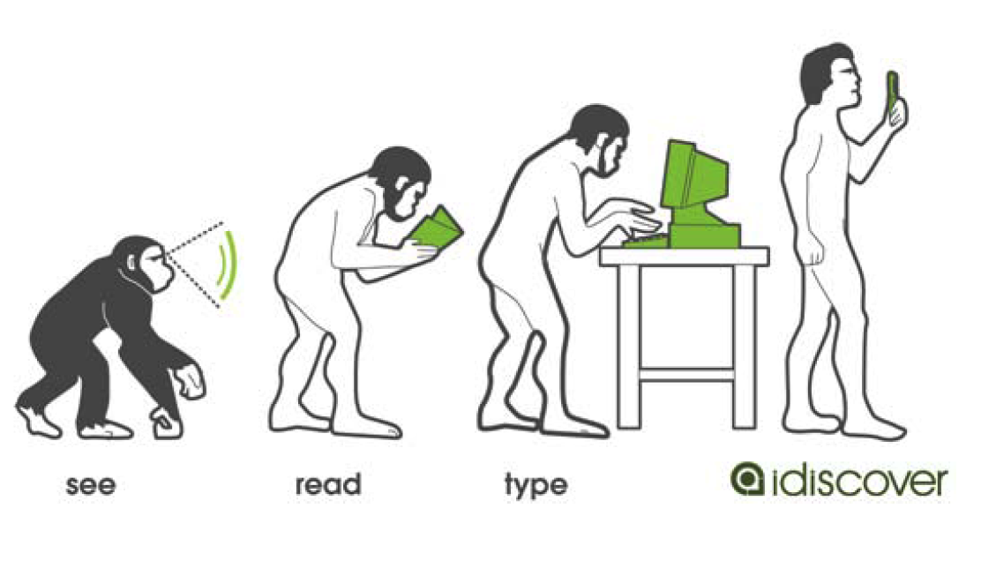
Mobile Visual Search - Linking Virtual and Physical Worlds -
Bernd Girod
Stanford University
bgirod@stanford.edu
[picture: John Hong, Qualcomm]

Slide 2
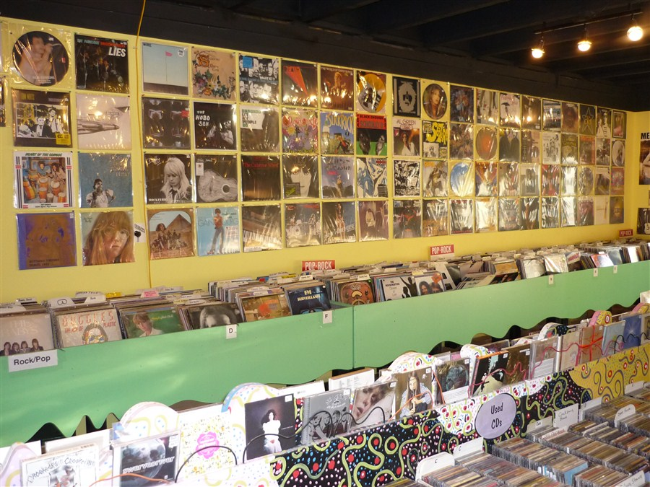
Browsing CDs and DVDs

Slide 3
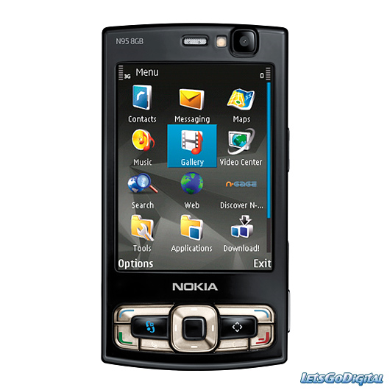
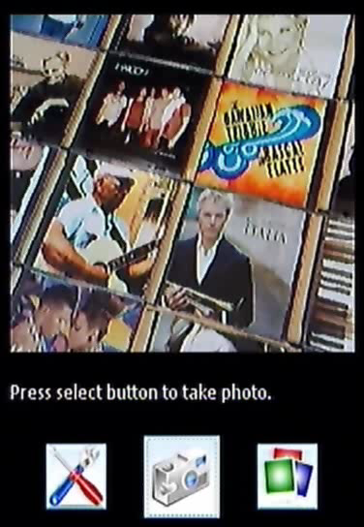
Browsing CDs and DVDs

Slide 4

Recognizing Video at a Glance

Slide 5
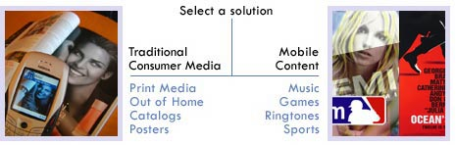
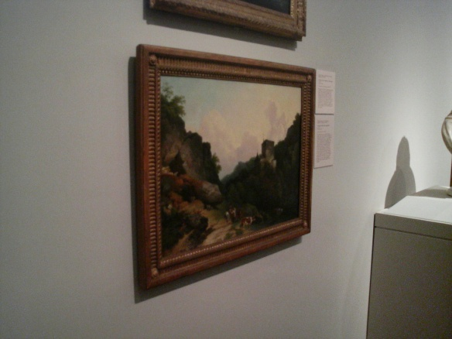
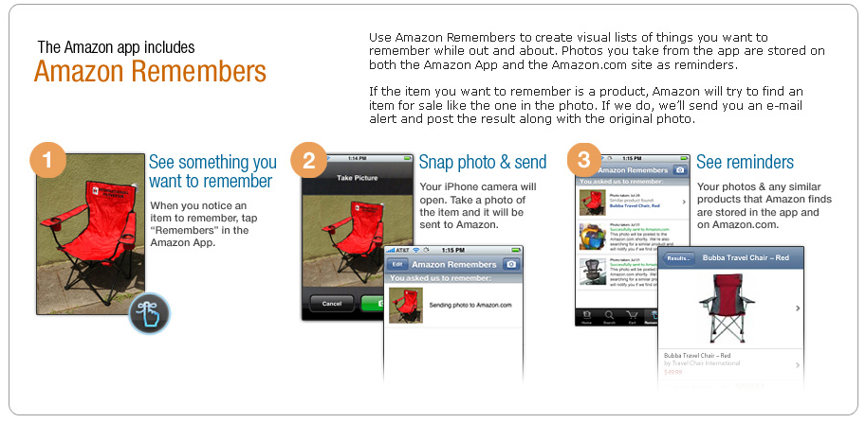
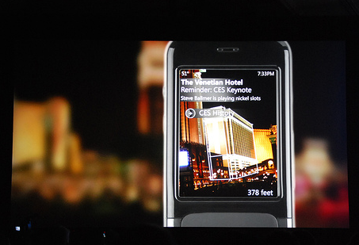
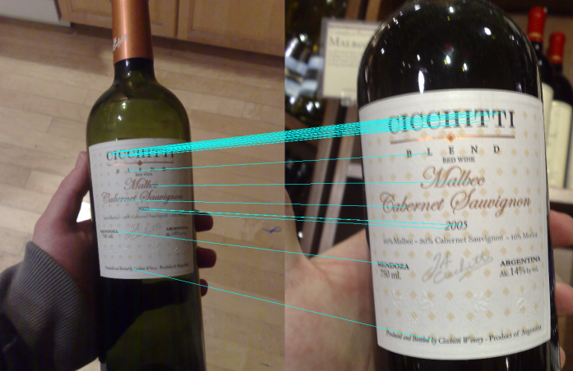
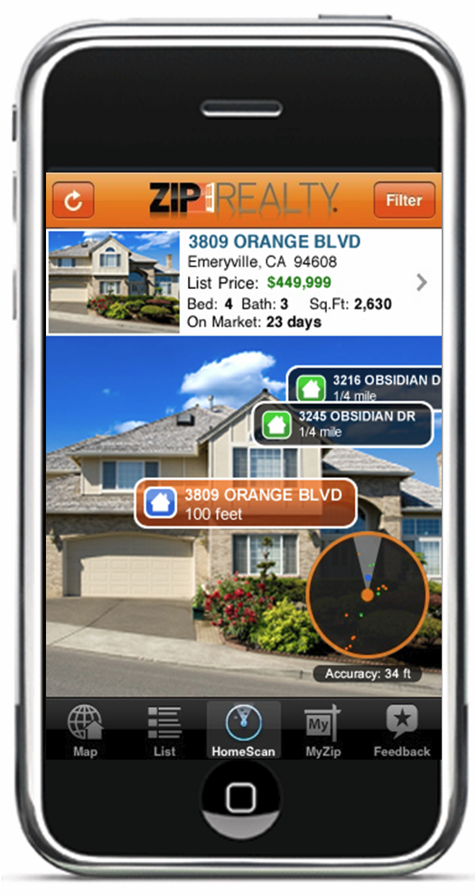
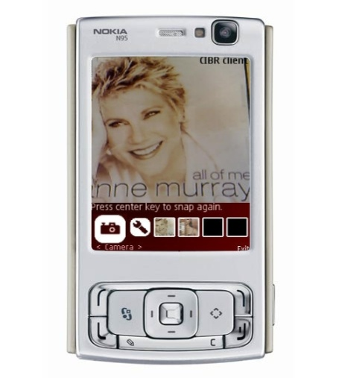
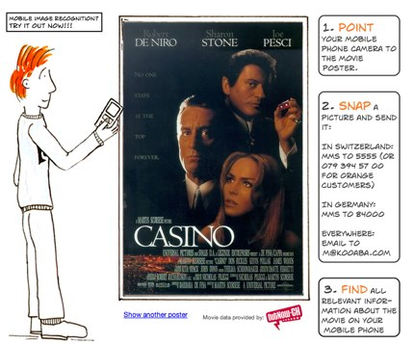
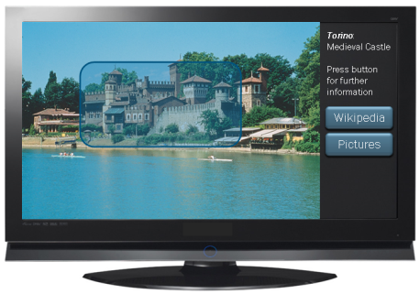
Visual Search Applications
Ads/Catalogs
Museum Guide
Comparison Shopping
Wine Labels
Landmarks
Real Estate
Augmented TV
Media covers
(CD, DVD, books)
Movie Posters

Slide 6
Outline
Computer vision: “Bag of Visual Words” matching
Feature compression
Phone-based vs. server-based processing
Towards mobile augmented reality

Slide 7

Representing a Text as a “Bag of Words”
We hold these truths to be self-evident, that all men are created equal, that they are endowed by their Creator with certain unalienable Rights, that among these are Life, Liberty and the pursuit of Happiness. That to secure these rights, Governments are instituted among Men, deriving their just powers from the consent of the governed, That whenever any Form of Government becomes destructive of these ends, it is the Right of the People to alter or to abolish it, and to institute new Government, laying its foundation on such principles and organizing its powers in such form, as to them shall seem most likely to effect their Safety and Happiness. Prudence, indeed, will dictate that Governments long established should not be changed for light and transient causes; and accordingly all experience hath shewn, that mankind are more disposed to suffer, while evils are sufferable, than to right themselves by abolishing the forms to which they are accustomed. But when a long train of abuses and usurpations, pursuing invariably the same Object evinces a design to reduce them under absolute Despotism, it is their right, it is their duty, to throw off such Government, and to provide new Guards for their future security.
self-evident
Liberty
truths
happiness
endowed
inalienable
Creator
pursuit
Life

Slide 8

Representing an Image as a “Bag of Visual Words”
?

Slide 9
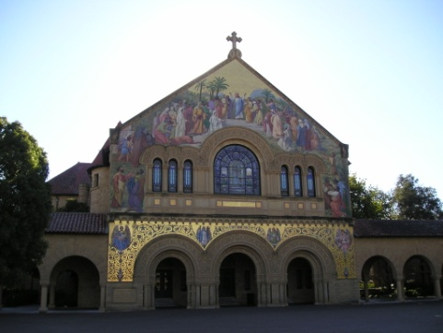

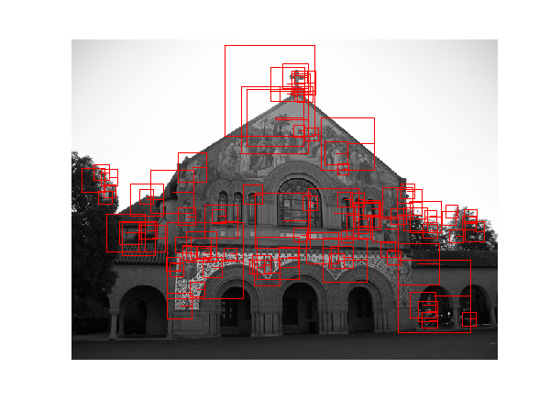
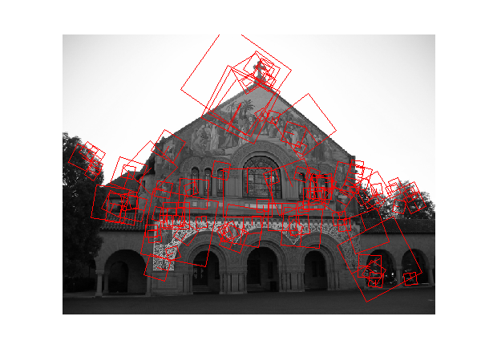

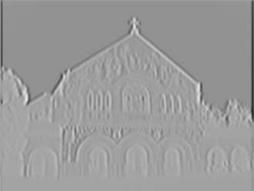





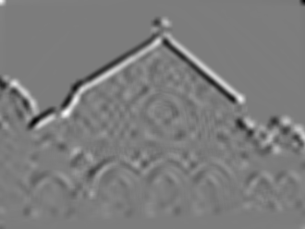





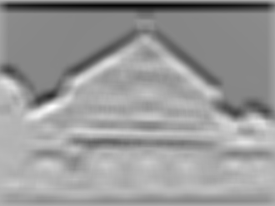


Computing Visual Words
scale
D_{xx}
Maxima
D_{xy}
y
D_{xx}D_{yy}-(0.9D_{xy})²
D_{yy}
x
Orient along
dominant gradient
Oriented Patch
Filters
Blob Response

Slide 10






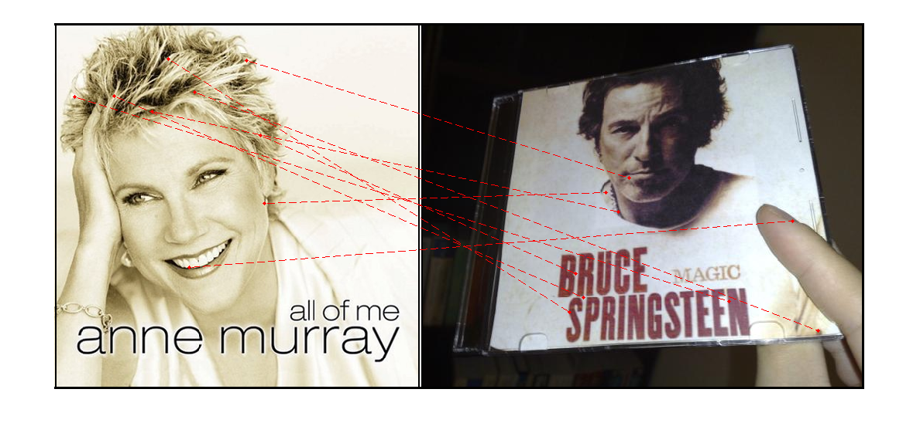

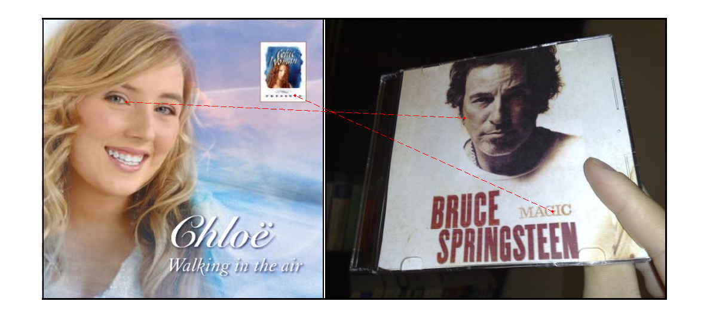
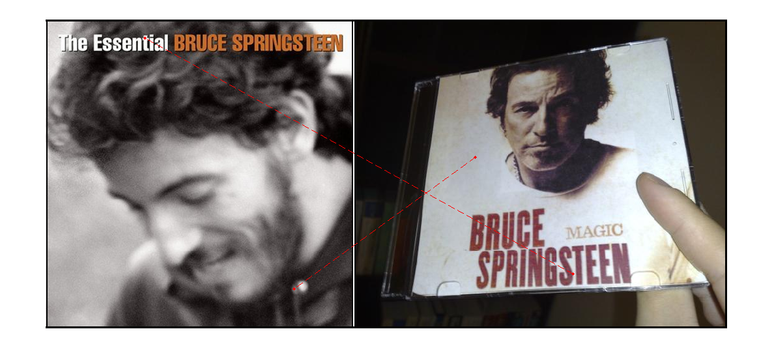
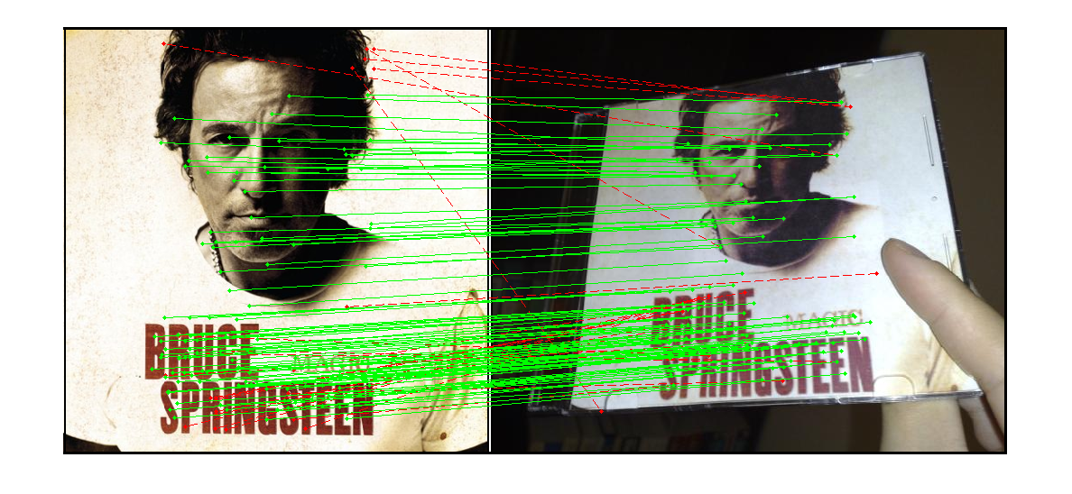
“Bag of Visual Words” Matching & Geometric Consistency Check
Pairwise Comparison

Slide 11





Growing Vocabulary Tree
[Nistér and Stewenius, 2006]

Slide 12
Growing Vocabulary Tree
[Nistér and Stewenius, 2006]

Slide 13
Growing Vocabulary Tree
k = 3
[Nistér and Stewenius, 2006]

Slide 14
Growing Vocabulary Tree
k = 3
[Nistér and Stewenius, 2006]

Slide 15

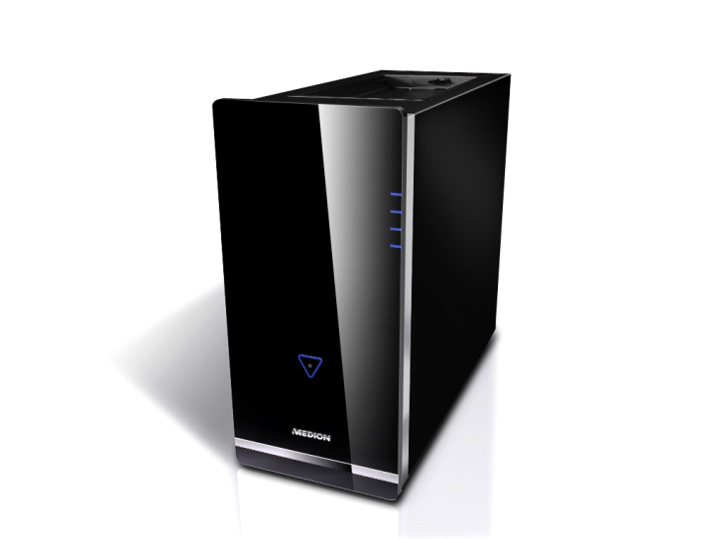


Querying Vocabulary Tree
Query

Slide 16
Architecture A: Send Image
20 kbps → 20 sec
Image
Wireless
Network
Information
Camera
Client
Server
Feature
Extraction
Feature
Matching

Slide 17
Architecture B: Send Features
Features
Wireless
Network
Information
Camera
Feature Extraction
Feature
Coding
Client
Server
Feature
Matching

Slide 18
Architecture C: Features on Phone
Wireless
Network
Features
Information
Camera
Feature Extraction
Feature
Matching
Client

Slide 19
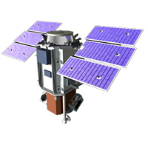
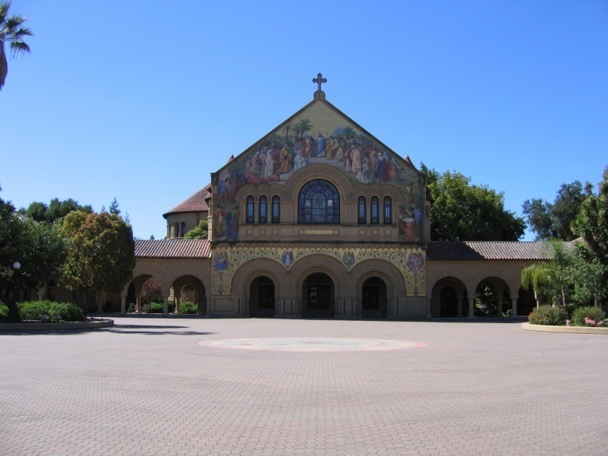
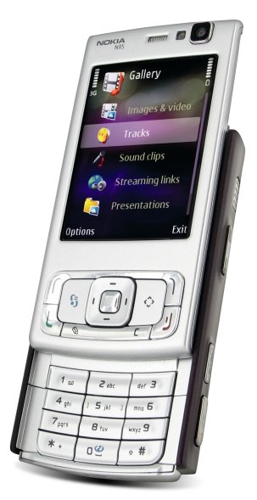
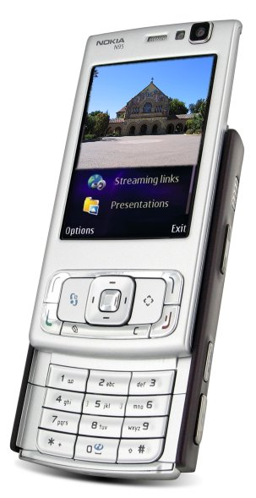

GPS-Aided Landmark Recognition Example for Feature Matching on the Phone
GPS
Memorial Church
Server

Slide 20
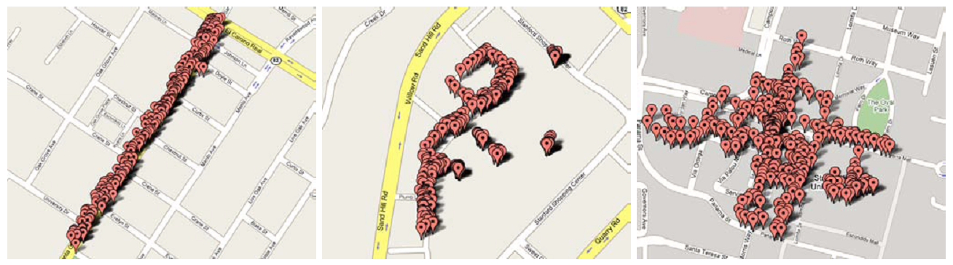
Prefetching Based on Location
Kernel
Loxel
Notes:
Location cell, loxel: 1 arc-second = ~30 m.
Kernel: Sliding window of loxels, here 3x3. Could also be 5x5.

Slide 21

GPS-Aided Landmark Recognition (2007)

Slide 22
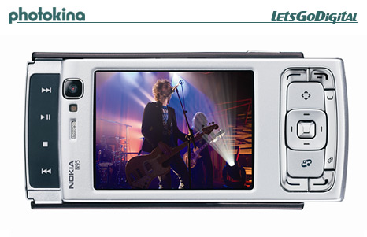



Transform Coding of SURF/SIFT Descriptors
Orthonormal Transform
Quantizer
Entropy
Coder
Original Descriptor
Client
Channel
Channel
Server
Decoded Descriptor
Inverse
Transform
Inverse
Quantizer
Entropy
Decoder
[Chandrasekhar et al., VCIP 2009]
Notes:
22

Slide 23
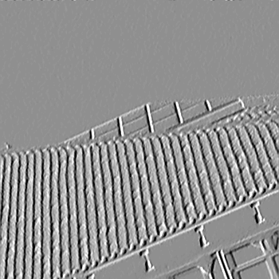

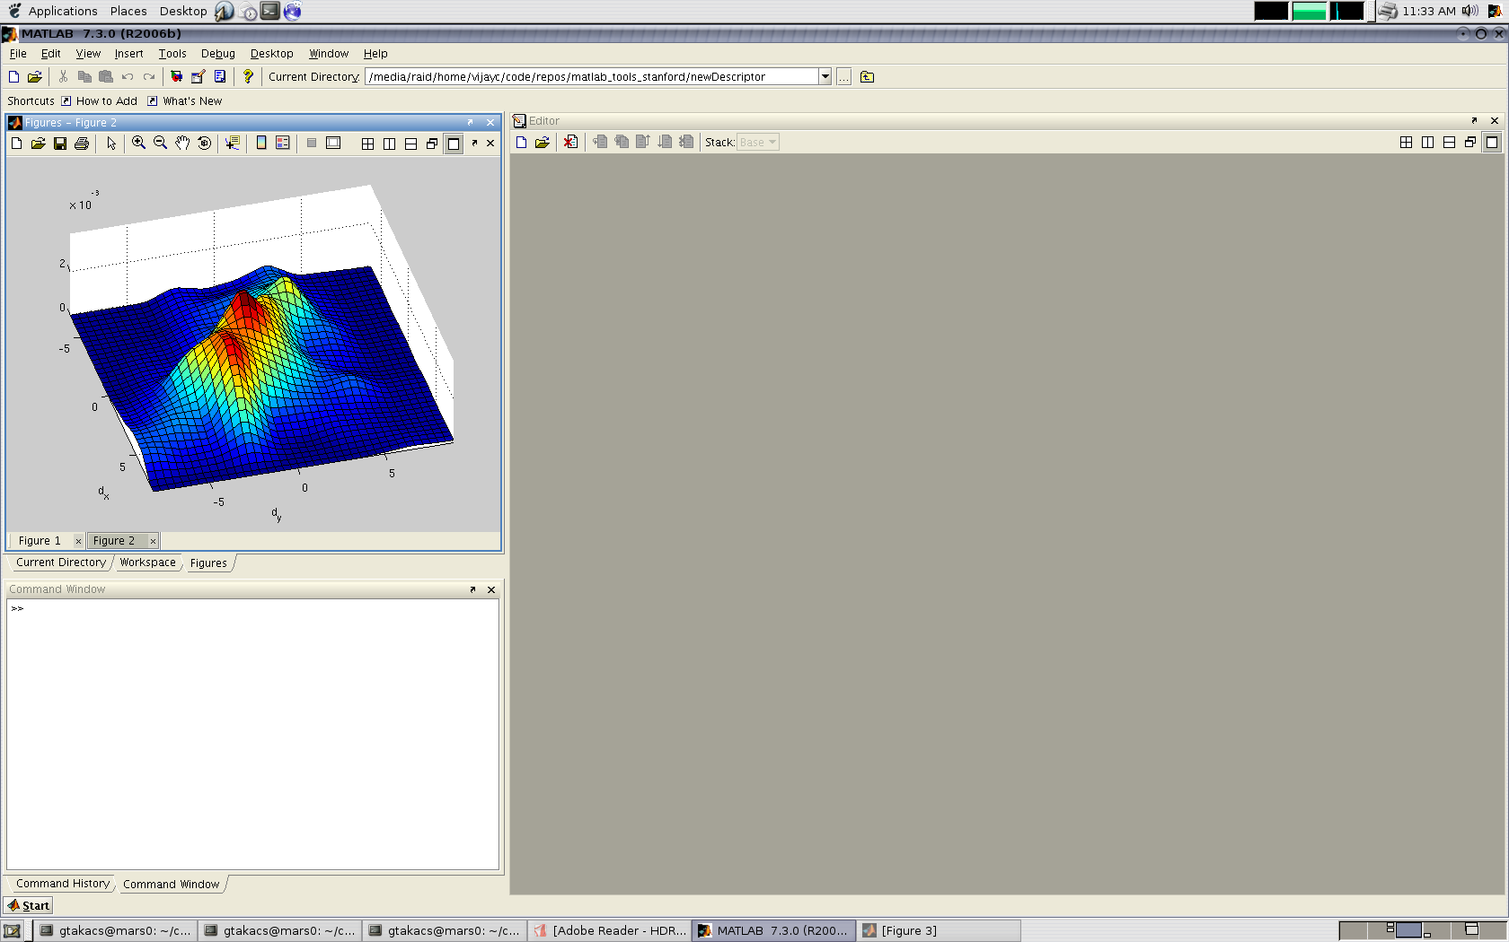
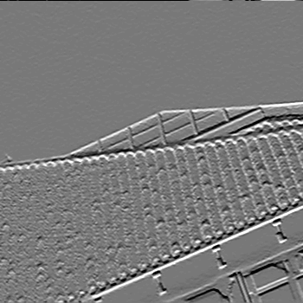
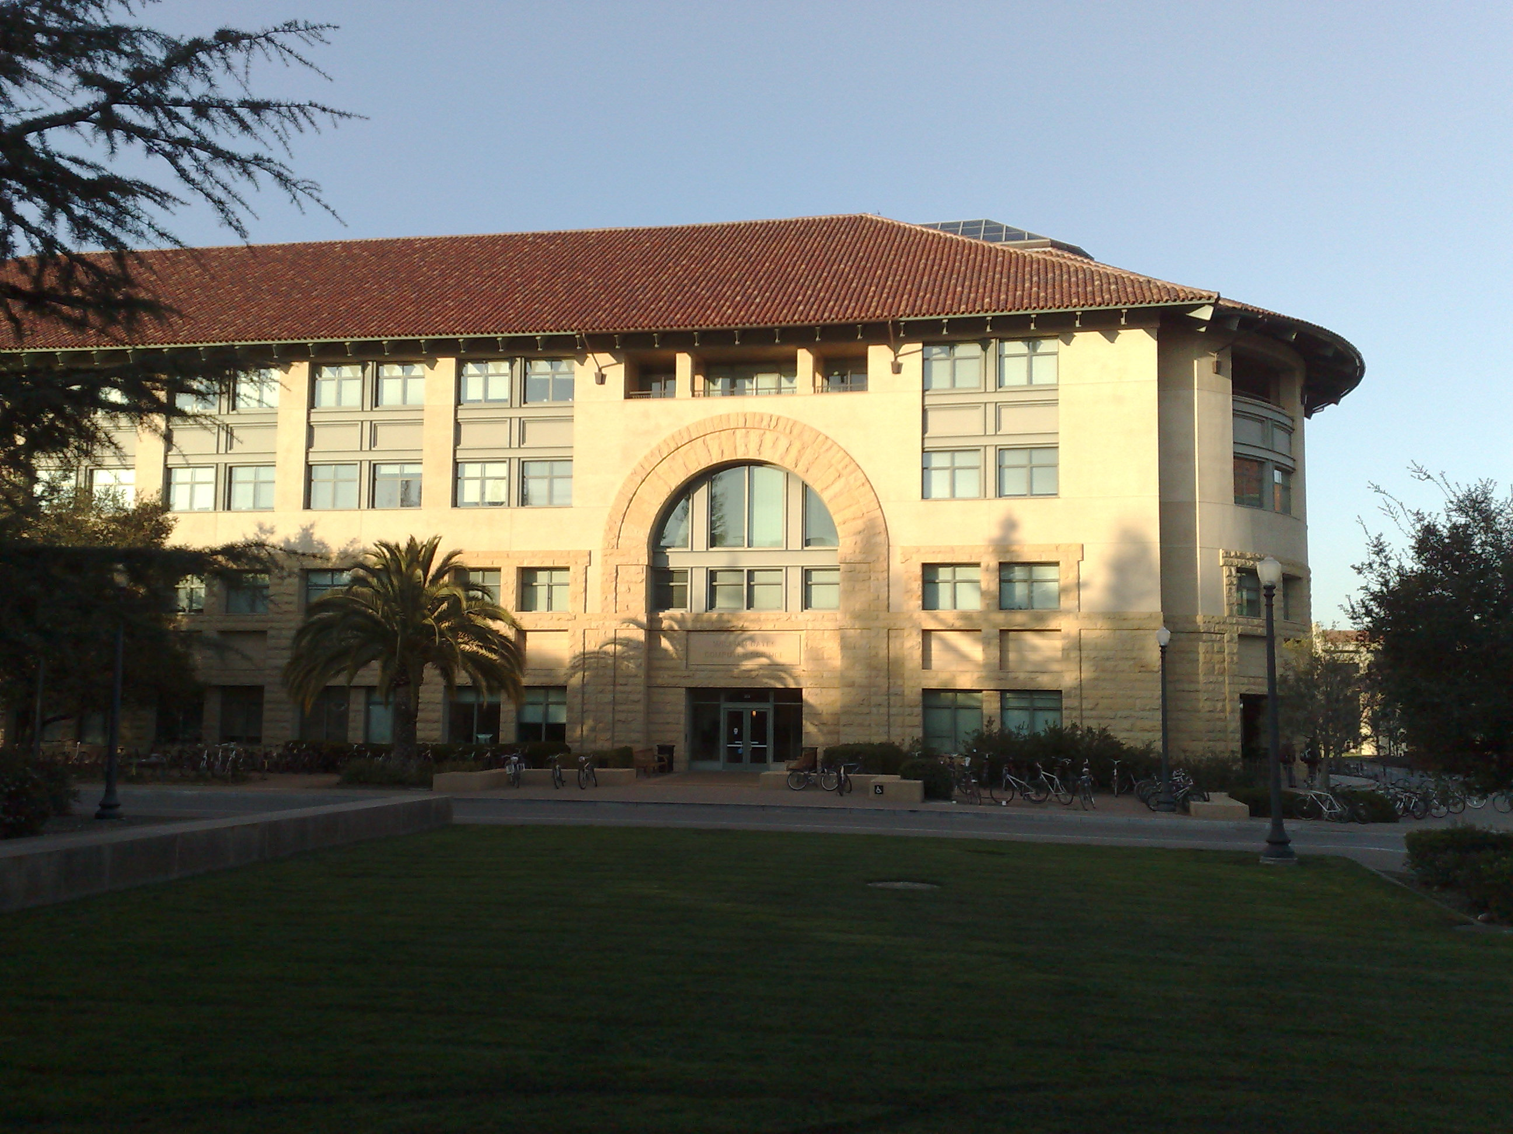
CHoG: Compressed Histogram of Gradients
Gradients
Gradient distributions
for each bin
Patch
d_{x}
d_{y}
d_{x}
d_{y}
011101
Spatial
binning
0100101
01101
Histogram
compression
101101
0100011
111001
0010011
01100
1010100
CHoG Descriptor

Slide 24
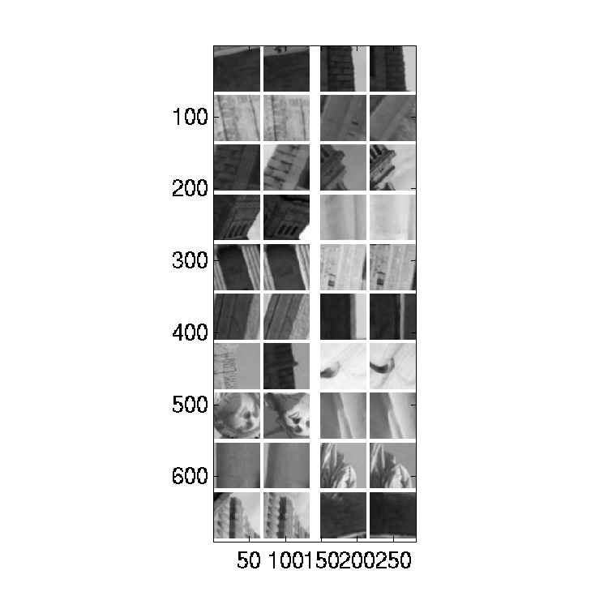
Feature Matching Performance
Ground truth data set of matching patches
Liberty data set
Bits per Feature Descriptor
[Winder & Brown CVPR ’09]

Slide 25
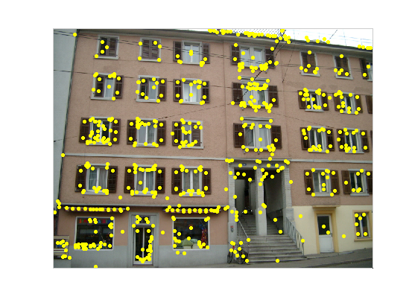
Location Histogram Coding
Feature
Locations
(x,y)
Spatial
Binning
Context-based
Arithmetic Coding
-
Quantize
Refinement Bits
+
[Tsai et al., MobiMedia 2009]

Slide 26
Compressed Feature Vector
52
84
1024
1088
Size (bits)
59
SIFT
Location x,y
1088 bits
CHoG
Location x,y
~ 84 bits
Compressed x,y → CHoG
~ 59 bits
[Tsai et al., MobiMedia 2009]
Notes:
26

Slide 27
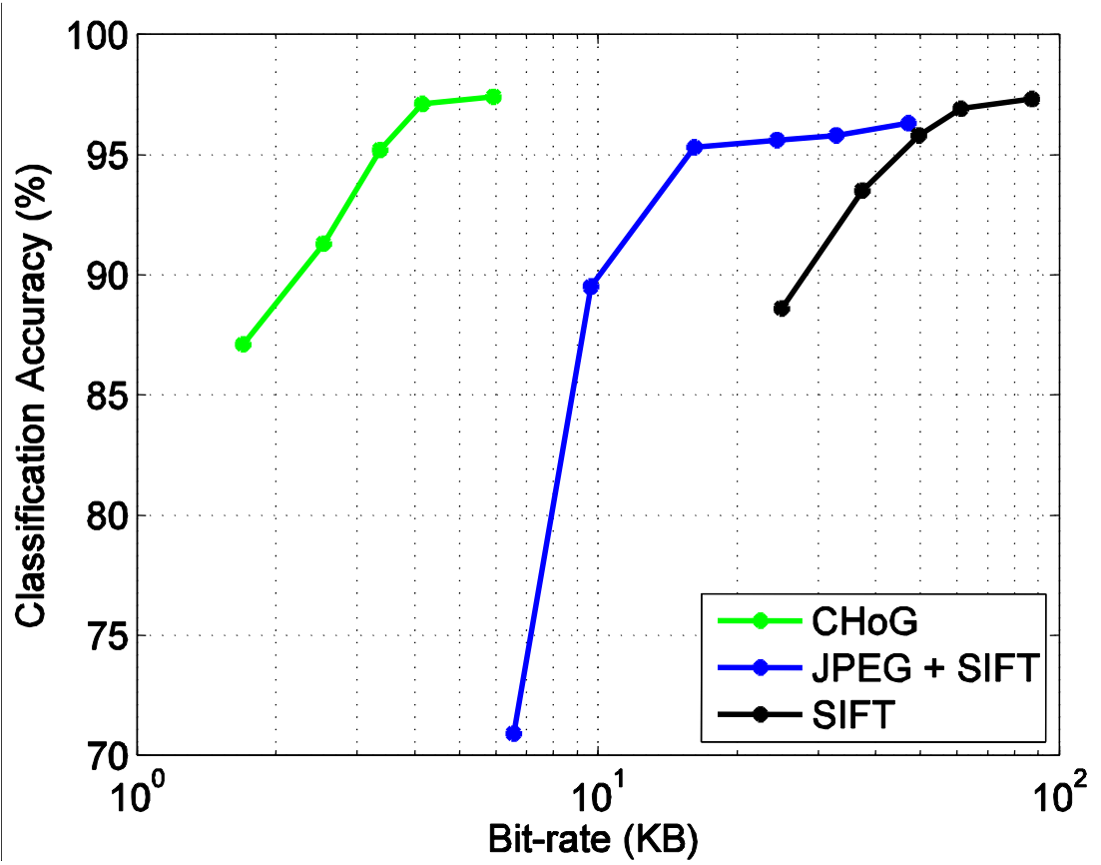
Image Retrieval Performance
Database: 1 million CD/DVD/book cover images
Accuracy % Recall @ 100% Precision
Query size (kByte)

Slide 28
Retrieval Latency
Nokia N95
330 MHz ARM
64 MB RAM
Uplink: | 20 kbps |  | 0.5 sec RTT
Server Delay
Execution Time (sec)
Upload
JPEG Image
40 kByte
Server Delay
Upload Features
2.2 kByte
Extract Features
“Send Features” “Send Image”
Architecture B Architecture A

Slide 29
Retrieval Latency
Nokia N95
330 MHz ARM
64 MB RAM
Uplink: | 60 kbps |  | 0.5 sec RTT
Execution Time (sec)
Server Delay
Upload
JPEG
Image
40 kByte
Server Delay
Upload 2.2 kByte
Extract Features
“Send Features” “Send Image”
Architecture B Architecture A

Slide 30
Retrieval Latency
Nokia N95
330 MHz ARM
64 MB RAM
Uplink: | > 1 Mbps | WLAN | 0.1 sec RTT
Execution Time (sec)
Server Delay
Extract Features
Server Delay
“Send Features” “Send Image”
Architecture B Architecture A

Slide 31
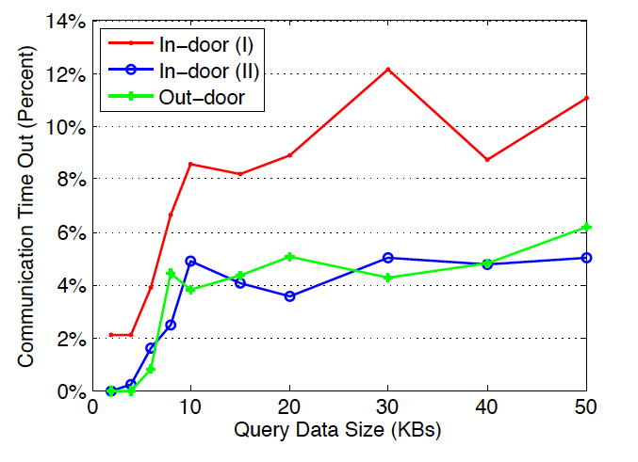
Time-Out Percentage (3G Network)

Slide 32
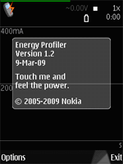
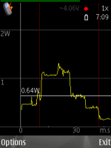
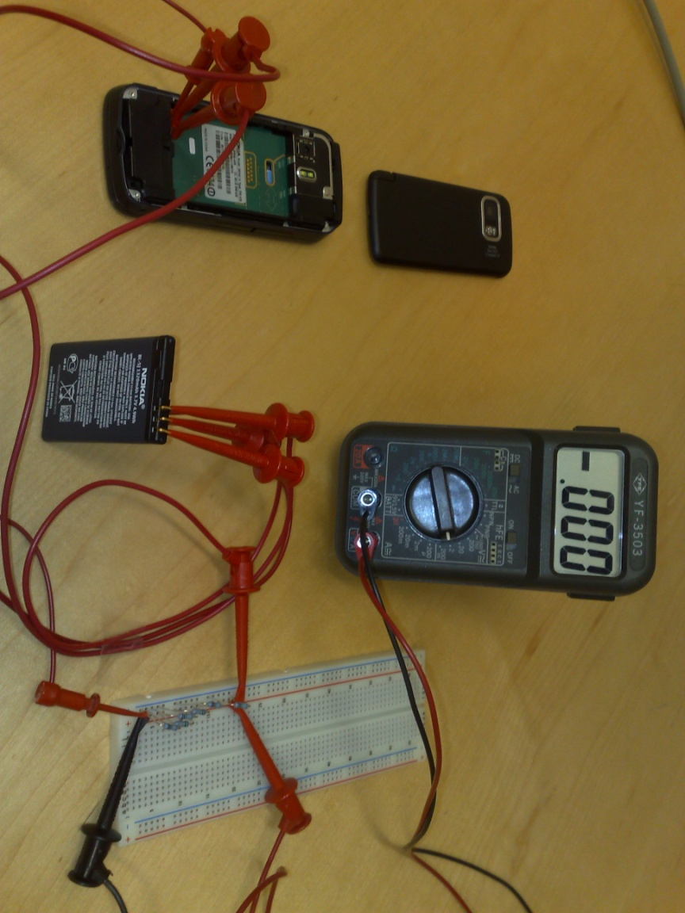
Power Consumption Per Query
Architecture B Architecture A

Slide 33

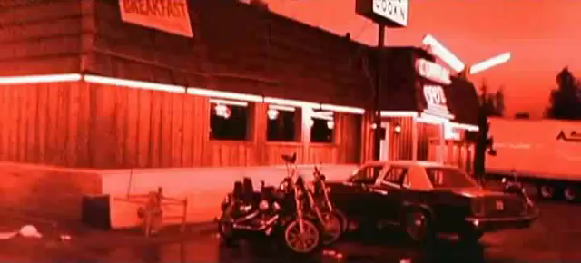
Augmented Reality

Slide 34


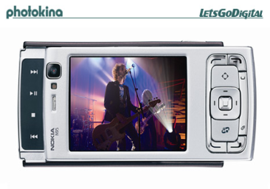



Mobile Augmented Reality
Server
Extract Features
Query VocTree
Check Geometry
Send Query Frame
Send ID and Geometry
Network
Low Motion
Compensate Camera Pose
Display ID and Draw Boundary
Time
High Motion
Track Camera Pose
Client
John Mayer
Inside Wants Out
…

Slide 35
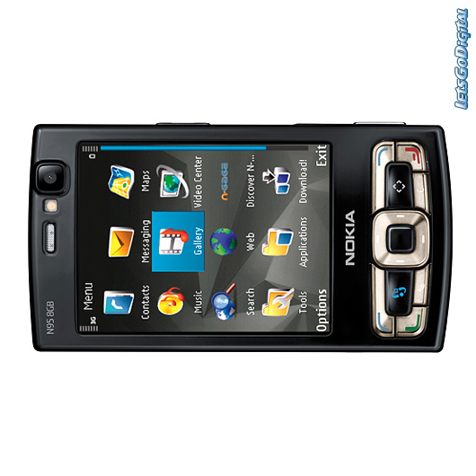

Mobile Augmented Reality: Books

Slide 36

Mobile Augmented Reality: CDs

Slide 37

Mobile Augmented Reality: Books on a Shelf

Slide 38
Concluding Remarks
Mobile Visual Search is ready for prime-time
Bag of Words approach: > 95% recall for > 1M database
Vocabulary trees for fast retrieval (1 sec for > 1M database)
Feature compression is a key problem
Sending a JPEG image as query can be slow ➔ send salient image features to server
Small database: store compressed database features on device
CHoG outperforms SIFT and SURF in rate-constrained recognition performance: ~60 bits incl. location
MPEG standardization “Compact Descriptors for Visual Search”
Mobile augmented reality
Very compelling user experience
Requires real-time tracking on mobile device
Still requires fast uplink (> 1Mbps)

Slide 39
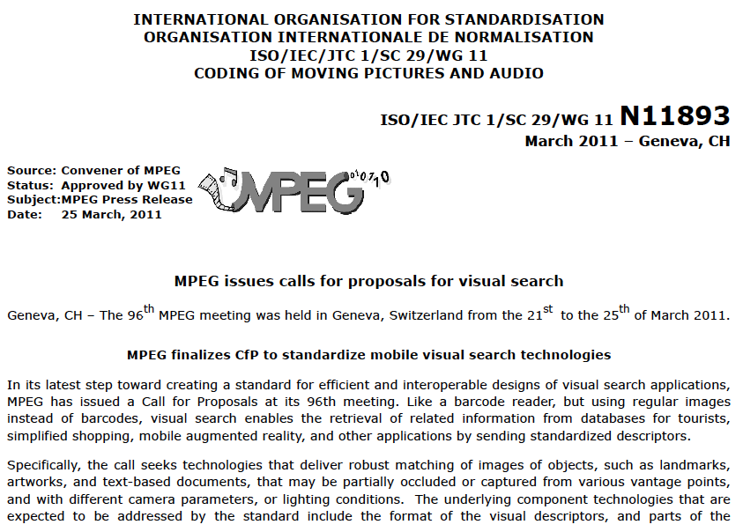
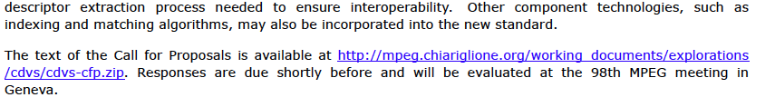

Slide 40
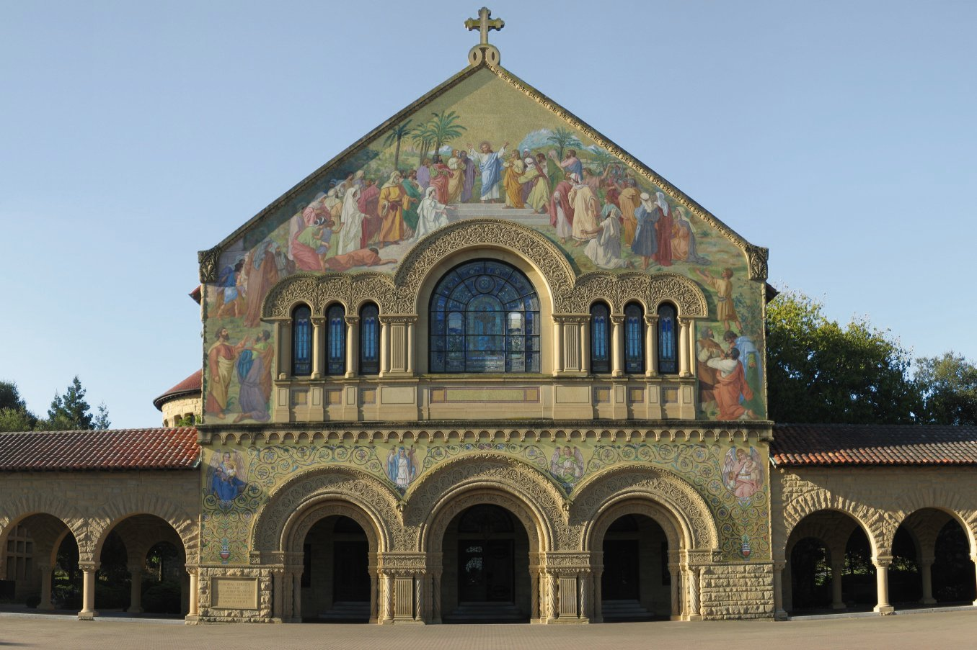


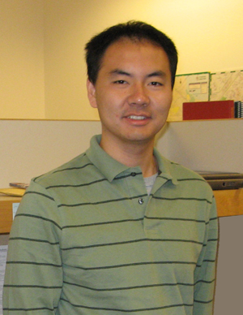


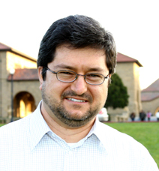



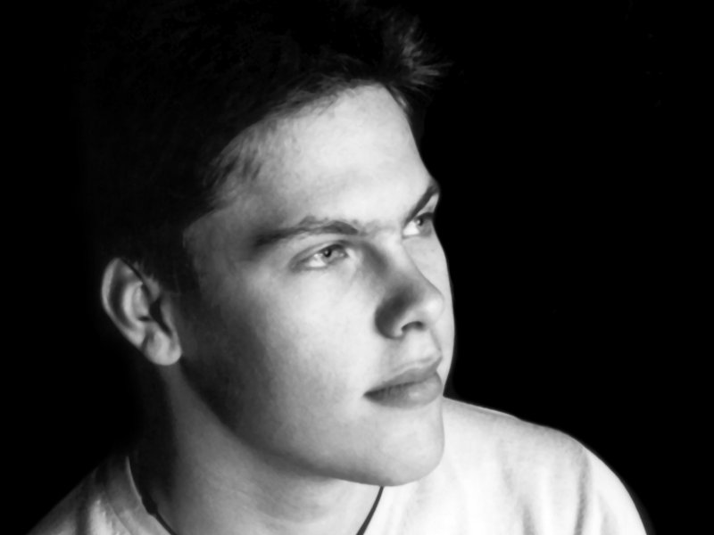






Acknowledgments
Radek
Grzeszczuk
David Chen
Vijay Chandrasekhar
Yuriy Reznik
Ramakrishna Vendantham
Wei-Chao Chen
Sam Tsai
Gabriel Takacs
Yingen Xiong
Kyu-Han Kim
Natasha Gelfand
Jatinder
Singh
Mina Makar
Notes:
Before I start, let me acknowledge numerous collaborators ….
… Stanford graduate students
… Nokia
… Deutsche Telekom Labs

Slide 41


Further Interest: SP Magazine July 2011

